Slide 1


Lifelong Links for adopted children

Slide 2

About Family Rights Group
Family Rights Group promotes policies and practices that keep children safe within their family and strengthen the family and community networks of those children who cannot live at home
National specialist advice service for parents & kinship carers
Research, Policy, Campaigns & Legal reforms
Innovative practices including Family Group Conferences & Lifelong Links
Families' voices shaping the child welfare system
www.frg.org.uk

Slide 3

The aim of
Lifelong Links
To create lifelong support networks for children and young people in and leaving the care system.

Slide 4
Lifelong Links: key principles
Young person driven
Child safety & welfare is central
Strength-based family centred approach
Enable participation for all
Independent coordinator
Supportive of all involved
A problem-solving dynamic approach

Slide 5
Sadie’s story
Film
Link to film

Slide 6
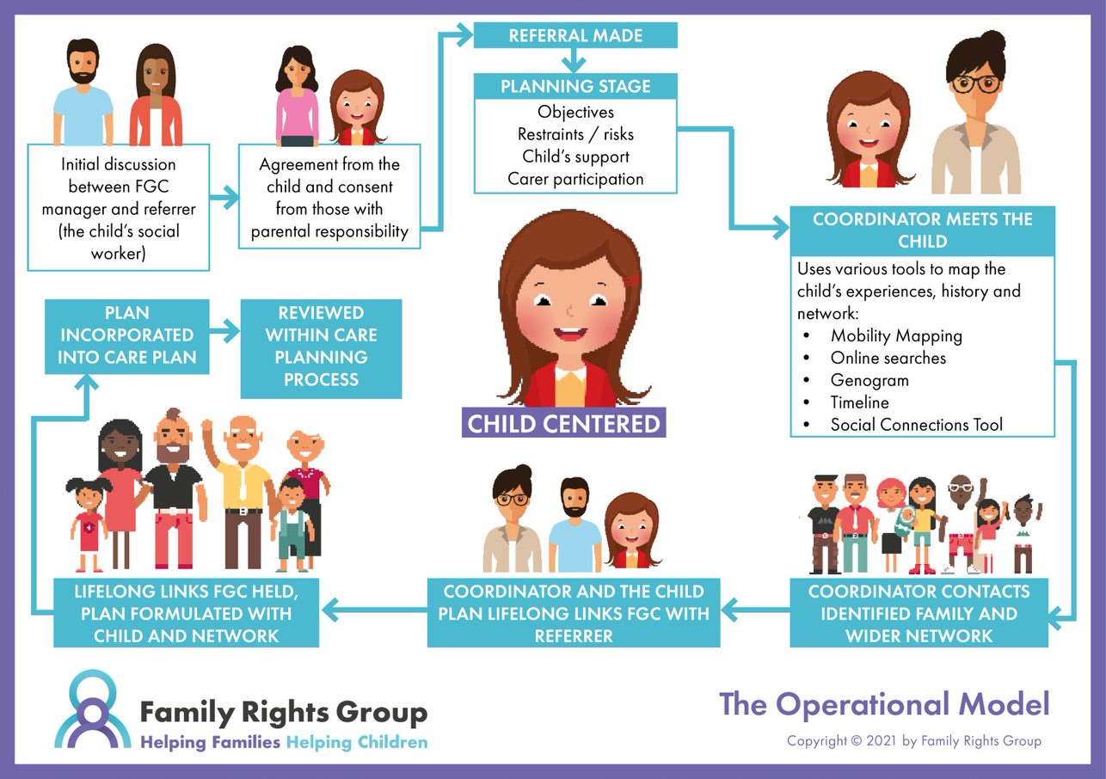


Slide 7




Lifelong Links evaluation report (2020)
Lifelong Links: embedding practice (2022)
Professor Lisa Holmes et al
Health and wellbeing
Placement stability
78% children and young people felt an improved sense of identity. The longitudinal child level analysis shows that emotional health and well-being appear to improve and that the improvement is sustained over time (as measured by the Strengths & Difficulties questionnaire).
Almost three-quarters (74%) of the children and young people who were referred remained in their placement in the year following Lifelong Links, compared to 41% for the comparison group. This has continued in the longitudinal study.
Increased connections
Cost Benefit analysis
On average children and young people increased their social networks (family, friends and connections with previous professionals) from 7 to 26 people.
The return on investment for Lifelong Links was shown to be 1.02.
This indicates that for each £1 invested in Lifelong Links there was a saving of £1.02.

Slide 8
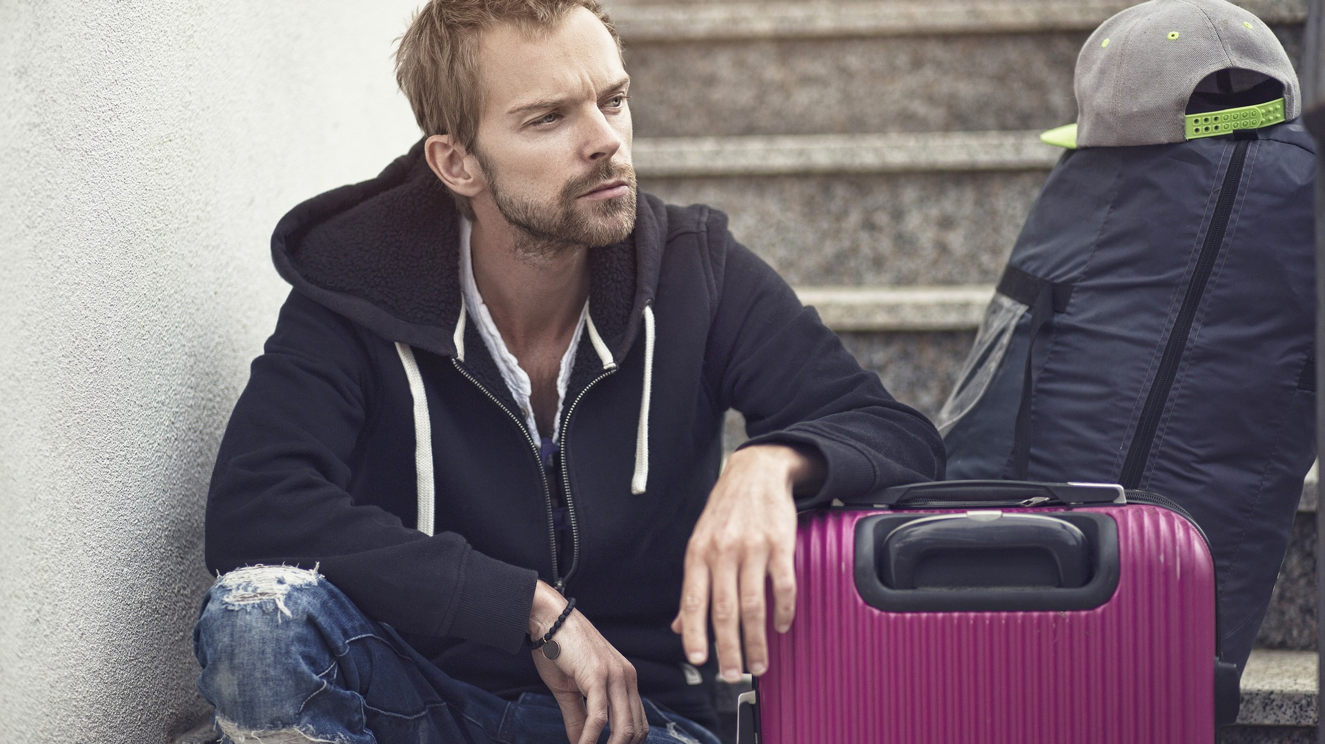
Lifelong Links reduces risk of homelessness for care leavers by 10%
Professor Michael Sanders, Public Policy at King’s College, London

Slide 9
Lifelong Links for adopted children
Initial reflection on Lifelong Links model
Identification of regional adoption agencies and Lifelong Links services for the initial phase
Discussions with voluntary adoption agencies and adoption support services
Consultation with adoption practitioners regarding potential areas for change or extra consideration
Legal reference group
Engagement with adoptees, adopters and birth families and other practitioners
Aim to work with 10 adopted young people and their families

Slide 10
Doncaster sibling story
Film
https://www.youtube.com/watch?v=zq2BKVPhuDk

Slide 11


