Slide 1

ARCBOX Communications
Management Application
Lynn Applegarth, ARC Adoption NE

Slide 2
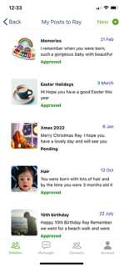
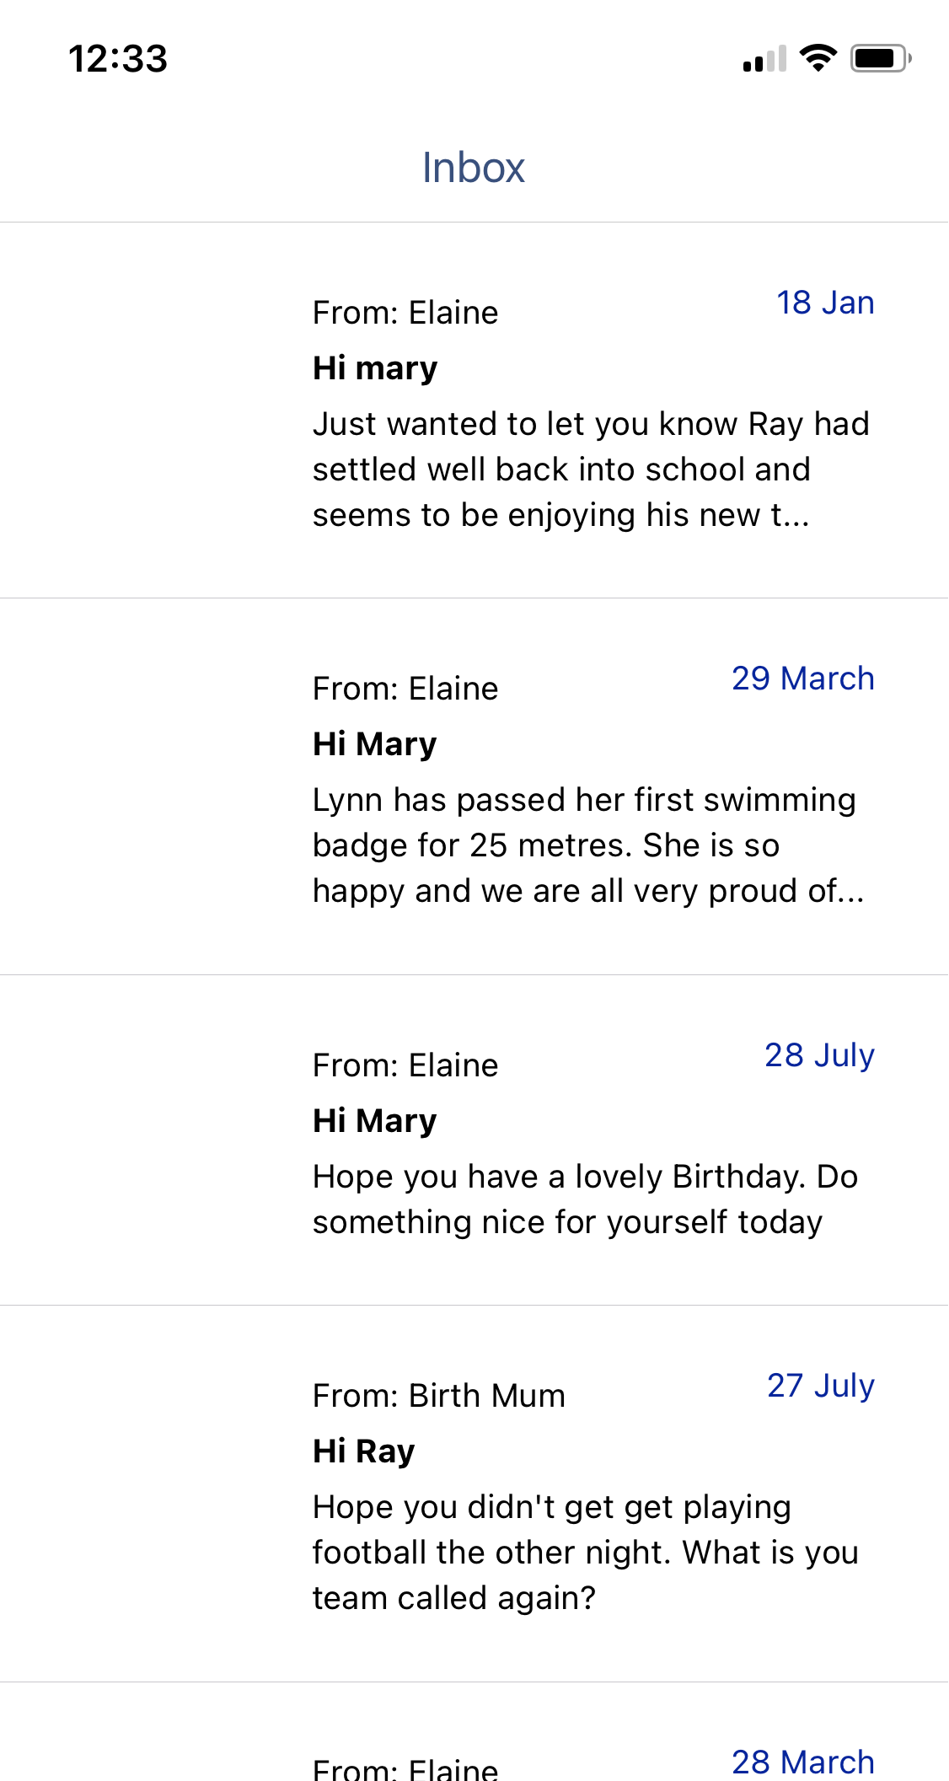
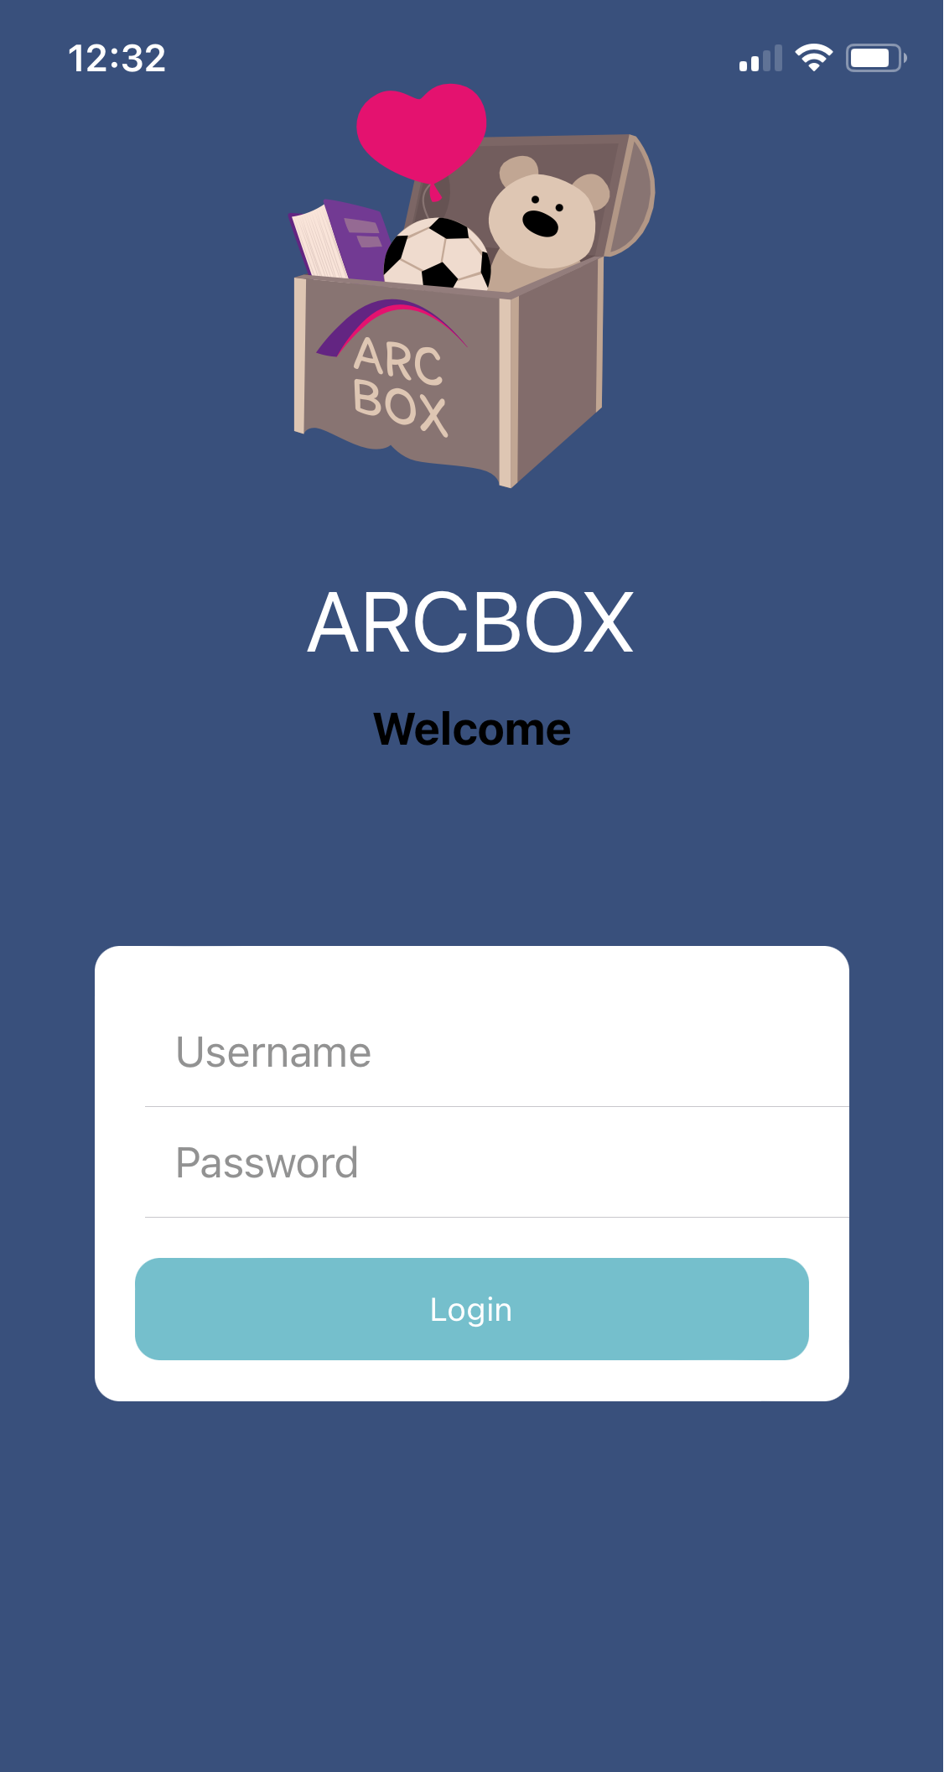
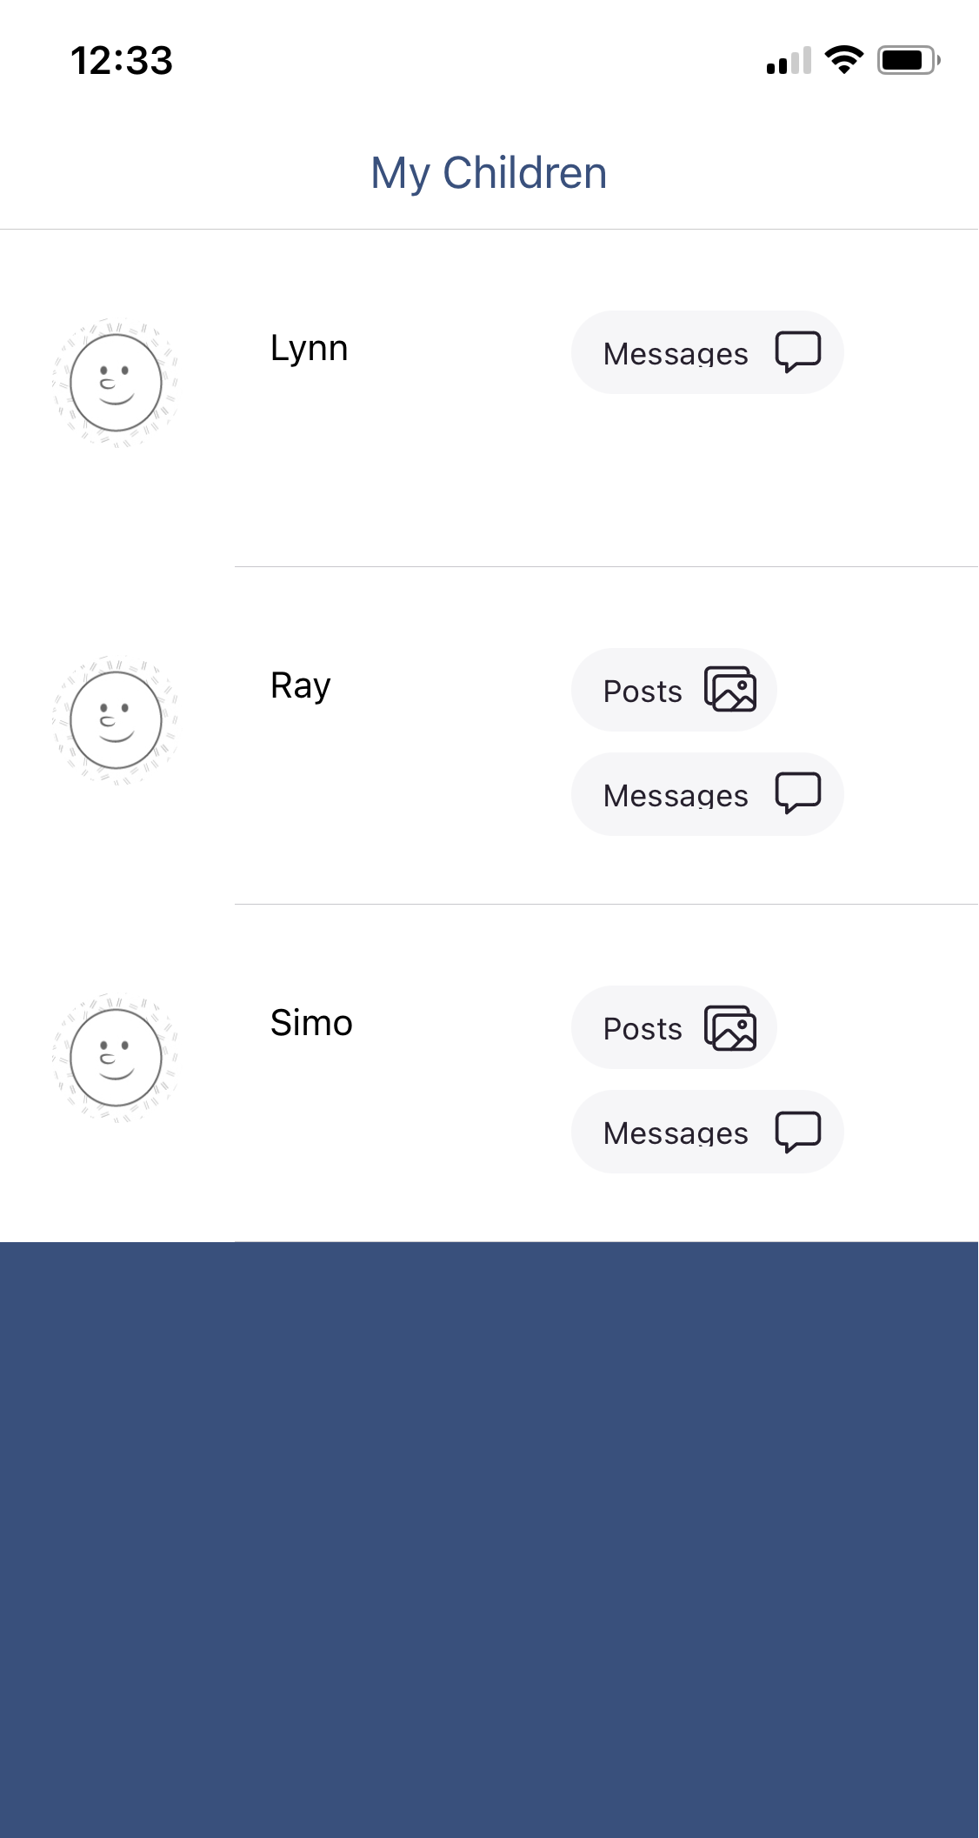
ARCBOX Mobile App

Slide 3

ARCBOX Communications App
The ARCBOX Communications App can be used to manage the varying contact scenarios between birth families and all care settings, providing a meaningful and lasting impact on the online safety and digital resilience of children within the social care system by enabling better integration within policies, systems and processes.
  The Communications Plan Manager enables effective management and coordination of all communications.
  The Secure Messaging provides secure, safe communication between children and significant people in their lives, in strict accordance with the communications plan.
  The Mobile App will provide easily accessible, managed communications by authorised contributors.
  The Post Box Manager enables recording and monitoring of communications in compliance with the plan.
This Communications App is integrated within digital life story ARCBOX, which enables all communications from significant people within a child’s life, to reside in one place for the child to access and own with their own secure login.

Slide 4

The pilot process
The aim of the pilot was to:
Identify and address potential risks
Identify and measure user engagement, uptake and any barriers to using a digital system
Identify opportunities for improvement to design and implementation of ARCBOX.
The timescale for the pilot was 12 months, July 2023 – July 2024, for organisations to access the ARCBOX Communications App including a six months period for participants to fully utilise the platform.
Who took part in the pilot?
4 LA’s/RAA’s took part in the fully funded pilot and were given the opportunity to invite 5 Children/Young People, with unlimited connections.
Children/Young People
Birth Relatives
Adopters
Professionals.

Slide 5
Barriers to piloting a digital system.
Some participants were unable to fully utilise the pilot and therefore chose not to participate.
Not being able to engage adopters (3), professional felt digital contact/life story would be best started at the beginning of the children and adopters' journey as future adopters may engage more if there are clear expectations, but others could take longer to overcome the barrier to digital communication and making the change from traditional contact.
Not being able to contact/engage (at least 3) birth relatives, one family started face to face contact, one family made contact via video calls, one family already communicated via WhatsApp. Another birth mum with learning needs was worried she’d lose her support with letter writing.
Feedback from professionals and adopters indicated that the infrastructure is not moving as fast as the culture change discussions and planned progress.

Slide 6
What did we learn from the pilot?
At the end of the pilot each participant received an anonymous online survey capturing both quantitative and qualitative data focusing on security, functionality, reliability and improvements.
How secure is the ARCBOX Communications App?
As we anticipated, security was a priority for all users. What we didn’t anticipate was that some users felt the security of ARCBOX was too high.
“The App itself is not very accessible and poorly designed compared to any other App that I use. Having to log in every time for use is frustrating (and a higher-level security than my banking or tax accounts), Within the App things are not intuitive and labelling of functions can be confusing.”
(Adopter)

Slide 7
How safe is the ARCBOX Communications App?
100% of children/young people gave a score of 9 for how secure they felt when using the App. (1 being not very secure and 10 being very secure).
100% of children/young people agreed that the communications App gives children and young people the ability to communicate safely with birth relatives including siblings.
62.5% of all participants agreed that the Communications App gives children and young people the ability to communicate safely with birth relatives/siblings.
37.5% of all participants scored the Communications App 8 or above for satisfaction.
100% of children/young people agreed that the App was able to do what it wanted them to do.
“I loved being able to talk to my sibling but disliked the App compared to others that I use.”
(Young Person)
The mobile ARCBOX Communications App layout is being restructured and redesigned with immediate effect taking into consideration all feedback.

Slide 8
How reliable is the ARCBOX Communications App?
100% of birth relatives rated the Communications App 5 for reliability.
66.6% of adopters gave a score of 10 for how much they liked the App, for ease of use and reliability.
33.3% of professionals rated 8 with regards to how satisfied they were with the overall performance, reliability and functionality of the Communications App.
A contributing factor to this score was due to professionals being unable to engage families in the pilot, therefore they didn’t feel that they were able to give a true score regarding satisfaction of using the App.
“Unfortunately, we couldn’t engage a family to use the App so it’s difficult to comment on the App itself but the support from ARC Adoption was fantastic.”
(Professional)

Slide 9
Satisfaction
100% of birth relatives gave the Communications App 5 or above for satisfaction.
66.6% of adopters rated the Communications App 9 or above for satisfaction
66.6% of professionals rated their satisfaction with the ease of onboarding as 5.
33.3% of professionals rated their satisfaction for ease of use as 8.
“This was a pilot and we were the first to use so we did a lot of testing out for ARC, this took much time. There were teething issues, log on issues for parents, everything was sorted through, but for myself it was time consuming. If I were given the App now it would be plain sailing……”. (Professional)
“I wasn’t using the App in my role I was monitoring from a PC computer, and this was well thought out.”
(Professional)
“It was easy to navigate when you got the hang of it but it’s difficult for adopters to engage in when their expectations of keeping in touch was already established.”
(Professional)

Slide 10
How beneficial is the ARCBOX Communications App?
66.7% of adopters gave a beneficial rating of 10 and 100% of adopters gave a beneficial rating rating of 7 or more.
100% of birth relatives gave a beneficial rating of 8.
“Potential to be great, sibling to sibling worked like a dream and they just ran with it at ages 12 and 17. With an adopter overseeing, it has brought a new level of connection for the adopted child with her brother who remained within the birth family. Our two birth mums have struggled, one with photos, the other just sending to the correct person, this is about their learning needs not the App. So therefore, I think this is very beneficial to have the option for those who are capable.”
(Professional)

Slide 11
What did the professionals think?
33.3% of professionals gave a beneficial rating of 10.
33.3% of professionals gave a beneficial rating of 7.
33.3% of professionals gave a beneficial rating of 5.
“Depends on children’s ages and how adopters choose to let their child be involved, this will be so varied, our adopter was super, and the child write his own messages and chose photos to send this all meant he could have communication when they wanted not sicking to annual letter. I think it normalised the communication and made it more real for him. For sibling to sibling this is great. Some choose to not use the App and use the PC as this shows better graphics and is where they can play with Avatar etc.”
(Professional)
“It was disappointing that we were unable to engage the adult in the process.” (Professional)
“The App wasn’t relevant for me as a worker once up and running. I only needed to know how it worked to advise users, any admin worker needs to see the full ARCBOX on a PC to manage it.” (Professional)

Slide 12
How can we improve ARCBOX?
Reduce security - able to stay logged in on the mobile App
Better online tutorials
Allow photos to automatically upload to a mobile phone’s photo gallery
Enable short Videos and voice messages.
“It did what we wanted it to do but there was an occasion when my child wanted to send a short video and there wasn’t an option for this.”
(Adopter)
“It does need to be heavily monitored of course for safeguarding reasons for our young people and birth family too. I can imagine it’s a bit daunting just like letterbox contact at first especially if there has been no previous communication and birth family would need support to start with. I wonder whether this could also be somehow rolled out to long-term fostering and SGO families? Long term foster placements often breakdown as young people reach their teens and a lot of that is down to not feeling they are in touch with their families enough, so end up searching on social media which isn’t safe but if something like this was available and could be monitored by foster carer etc would they feel more in control of their lives?”
(Adopter)

Slide 13
Food for thought
100% of birth relatives and 66.6% of adopters would like to continue to use the ARCBOX Communications App after the pilot period ended.
Professionals reported a difficulty in engaging users, particularly those with additional learning needs. Findings show that digital inequality and poverty is a barrier for many birth relatives who would like to access the ARCBOX Communications App. A key recommendation is to ensure that the application is fully accessible with a more detailed support package to enable all users to access the App. The possibility that organisations provide birth relatives with access to a device and Wi-Fi at a location where they can access birth family support, for example a drop in facility.
One agency said: “ARCBOX was fluid and flexible and the idea is brilliant!’ They felt “times are changing, and plans were becoming far more fluid”
There was a general consensus that ARCBOX Communications App is “a great way to manage communication and connection between all families involved and hopefully a stepping stone to families being reunited in whichever way is safe and possible.”

Slide 14
Would you like to know more about the ARCBOX Communications App and Pilot Evaluation?
For those that would like to know more, an in-depth evaluation report is available.
A full report can be found at https://www.arcadoptionne.org.uk/arcbox-digital-life-story-and-communications-app
Any queries about ARCBOX can be directed to Lynn.Applegarth@arcadoptionne.org.uk or info@arcbox.co.uk

